Slide 1


By:
Maxwell A. Fine
Supervisors:
Dr. Cameron Van Eck
Dr. Bryan Gaensler
Developing a Robust Error Analysis For The POSSUM Sky Survey
Pauline Voß
https://getavataaars.com/

Slide 2
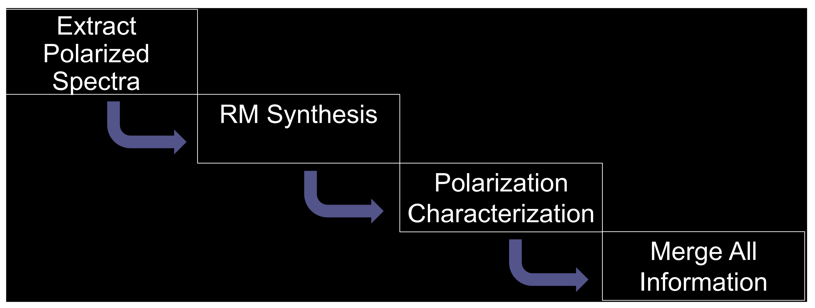
POSSUM 1D Data Pipeline
POSSUM’s data pipeline prepares the data for practical use
The data pipeline takes in the raw data and outputs RM results to a catalog
Having statistically accurate uncertainties is critical for future studies
The focus of this project is testing how accurate the outputted uncertainties are of the pipeline

Slide 3
Testing Methods
Simulations!
First checked that the simulations gave expected results with RM-TOOLS
Simulations of compact radio sources injected to real (POSSUM Pilot 1) data to test pipeline
After pipeline, compared pipeline outputs to ground truths of simulations
analyzed the raw and normalized residuals as a function of signal to noise

Slide 4
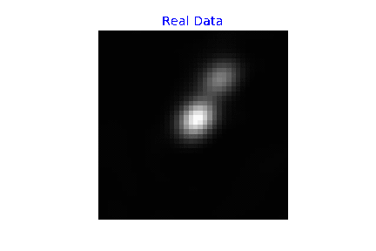
Simulation Parameters
Tested with 5,000 simulation sources
Uniform random distributions for all variables except fractional polarization which was a Gaussian
RM range -1000 to 1000 rad/m²
Polarization angle range 0 to 180 deg
Spectral index range -2 to 2
I₀ range 300 to 30000 µJy
p was Gaussian -center at 0.05, sigma of 0.04

Slide 5
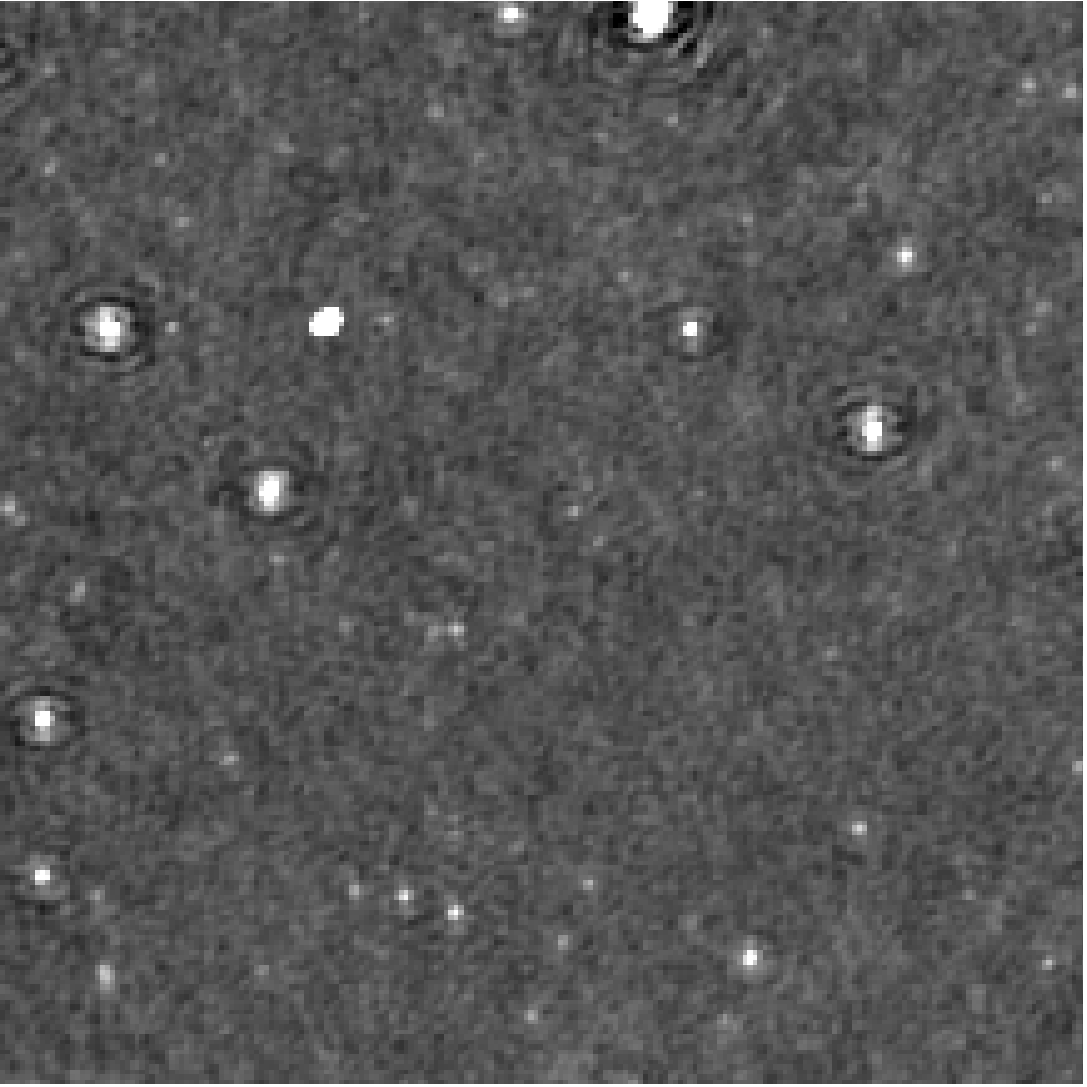
Injected Simulations
Data cubes from SB10168 of POSSUM Pilot 1

Slide 6
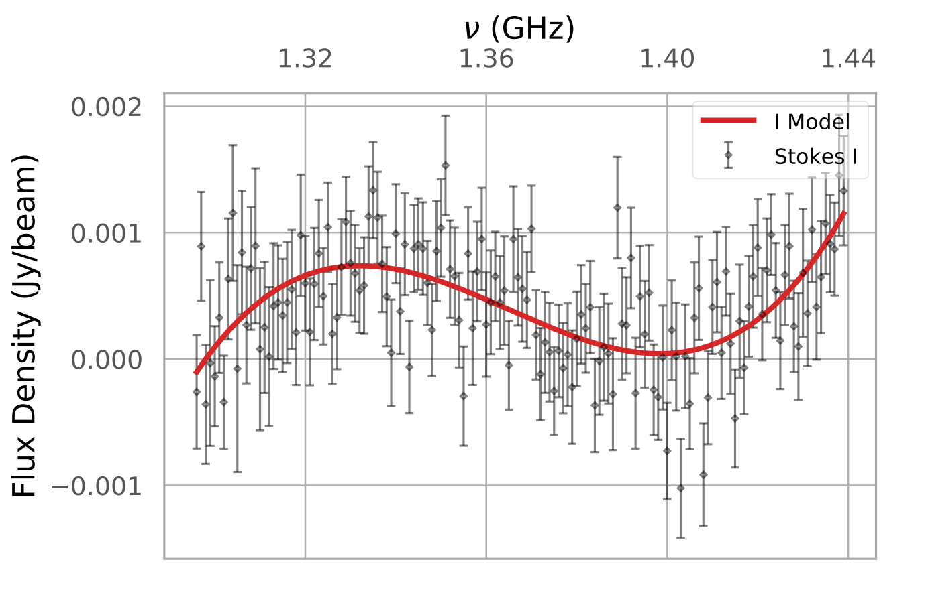
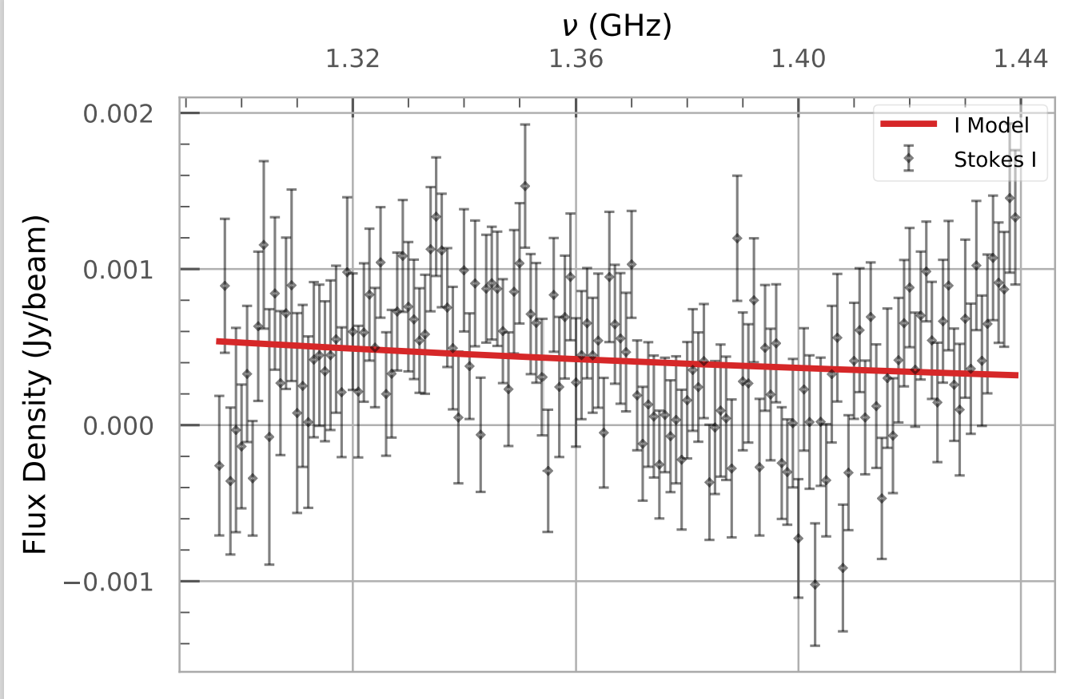
Dynamic Stokes I Fitting:
Before Correction:
After Correction:

Slide 7
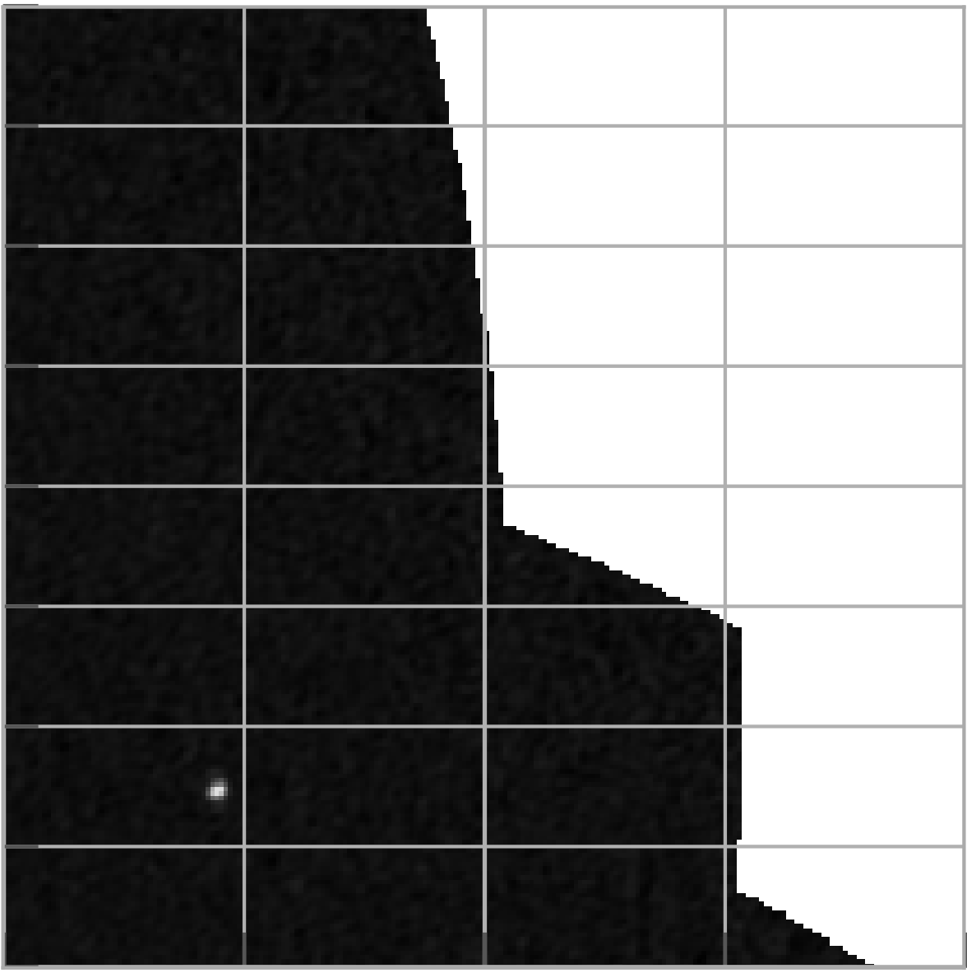
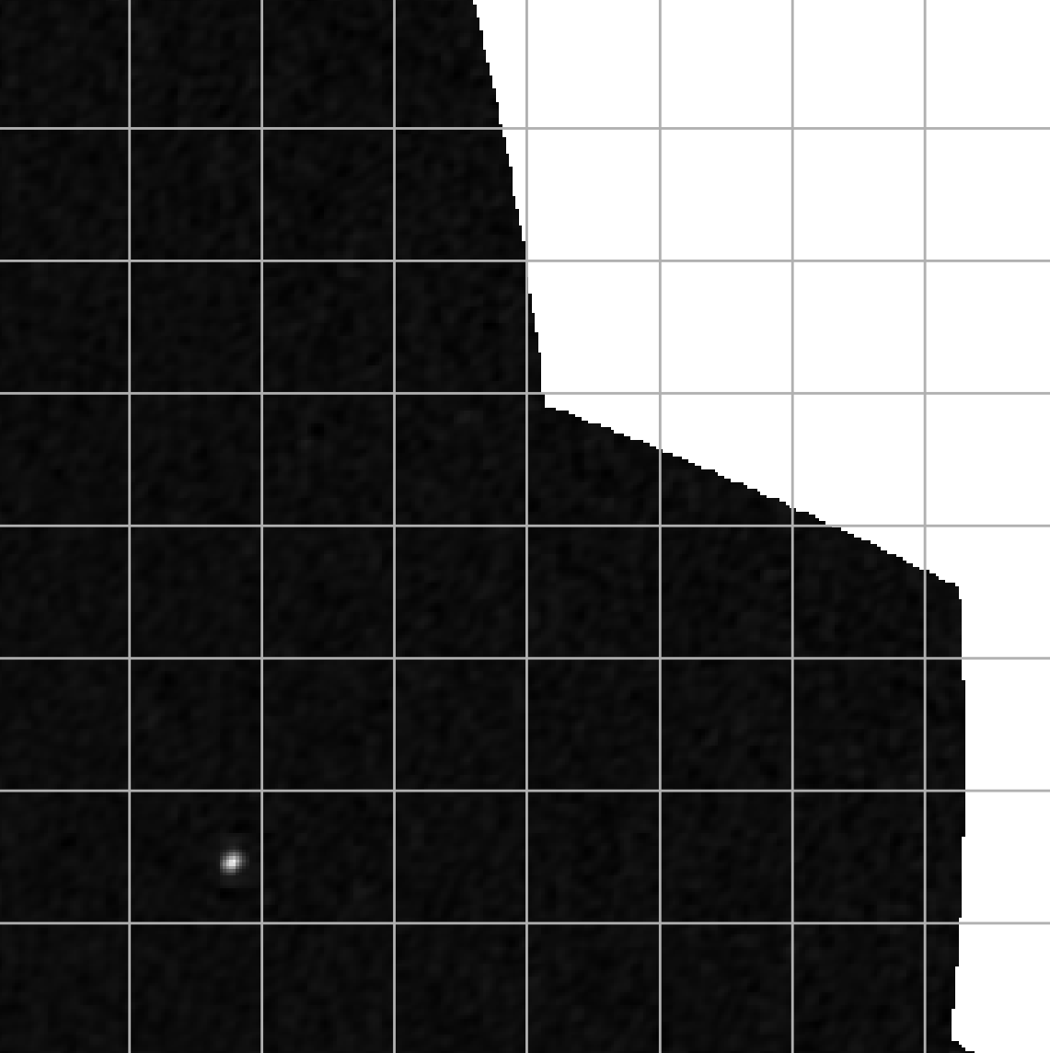
Edge Effects:
The two images above are of the same simulated radio source near the edge of the image. The left panel is at 1.3 GHz, while the right is at 1.45 GHz. Sources near the edges have data at some frequencies but not at other frequencies.

Slide 8
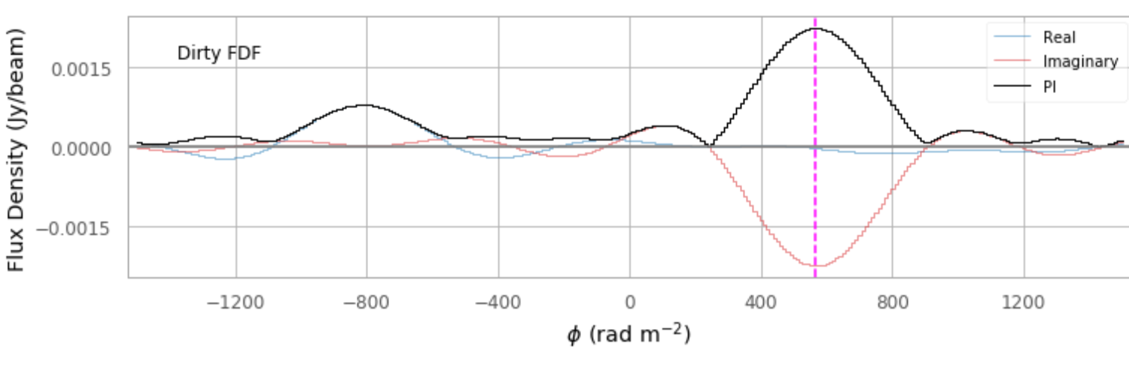
Double Sources:

Slide 9
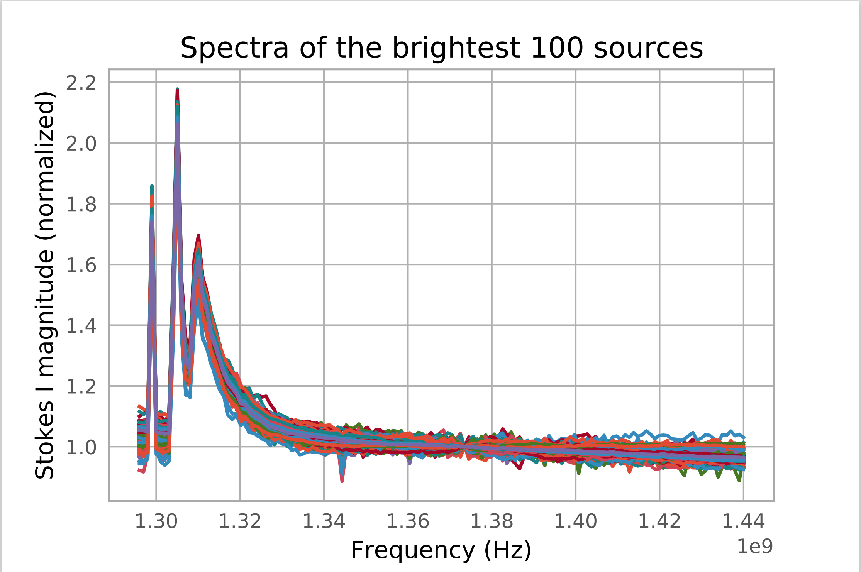
Bad behavior here is not considered by the Stokes I fitting tool

Slide 10
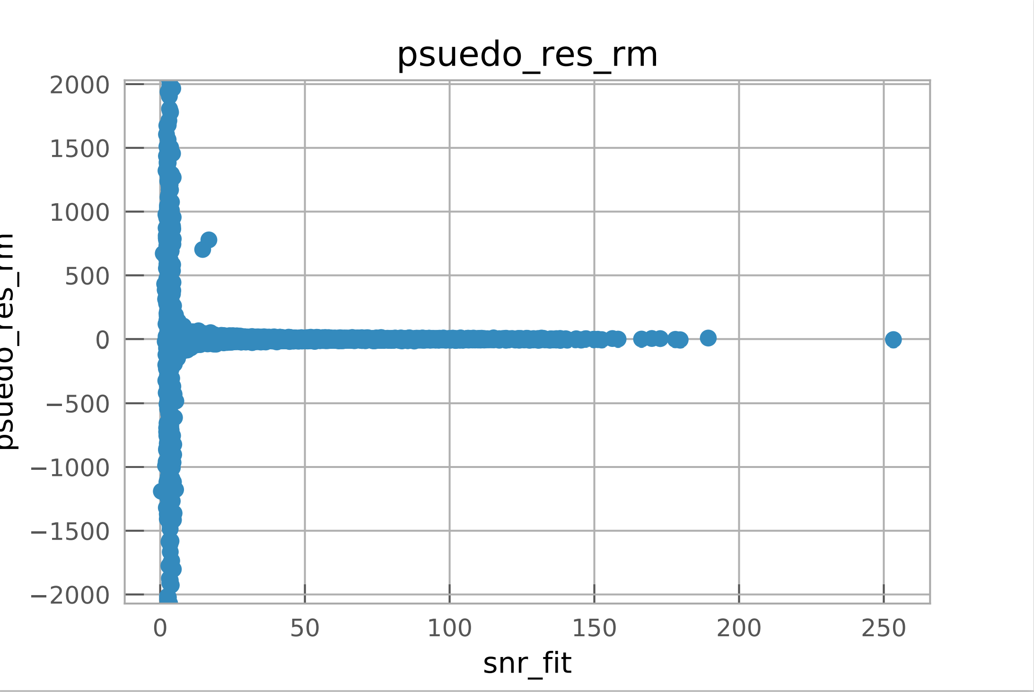
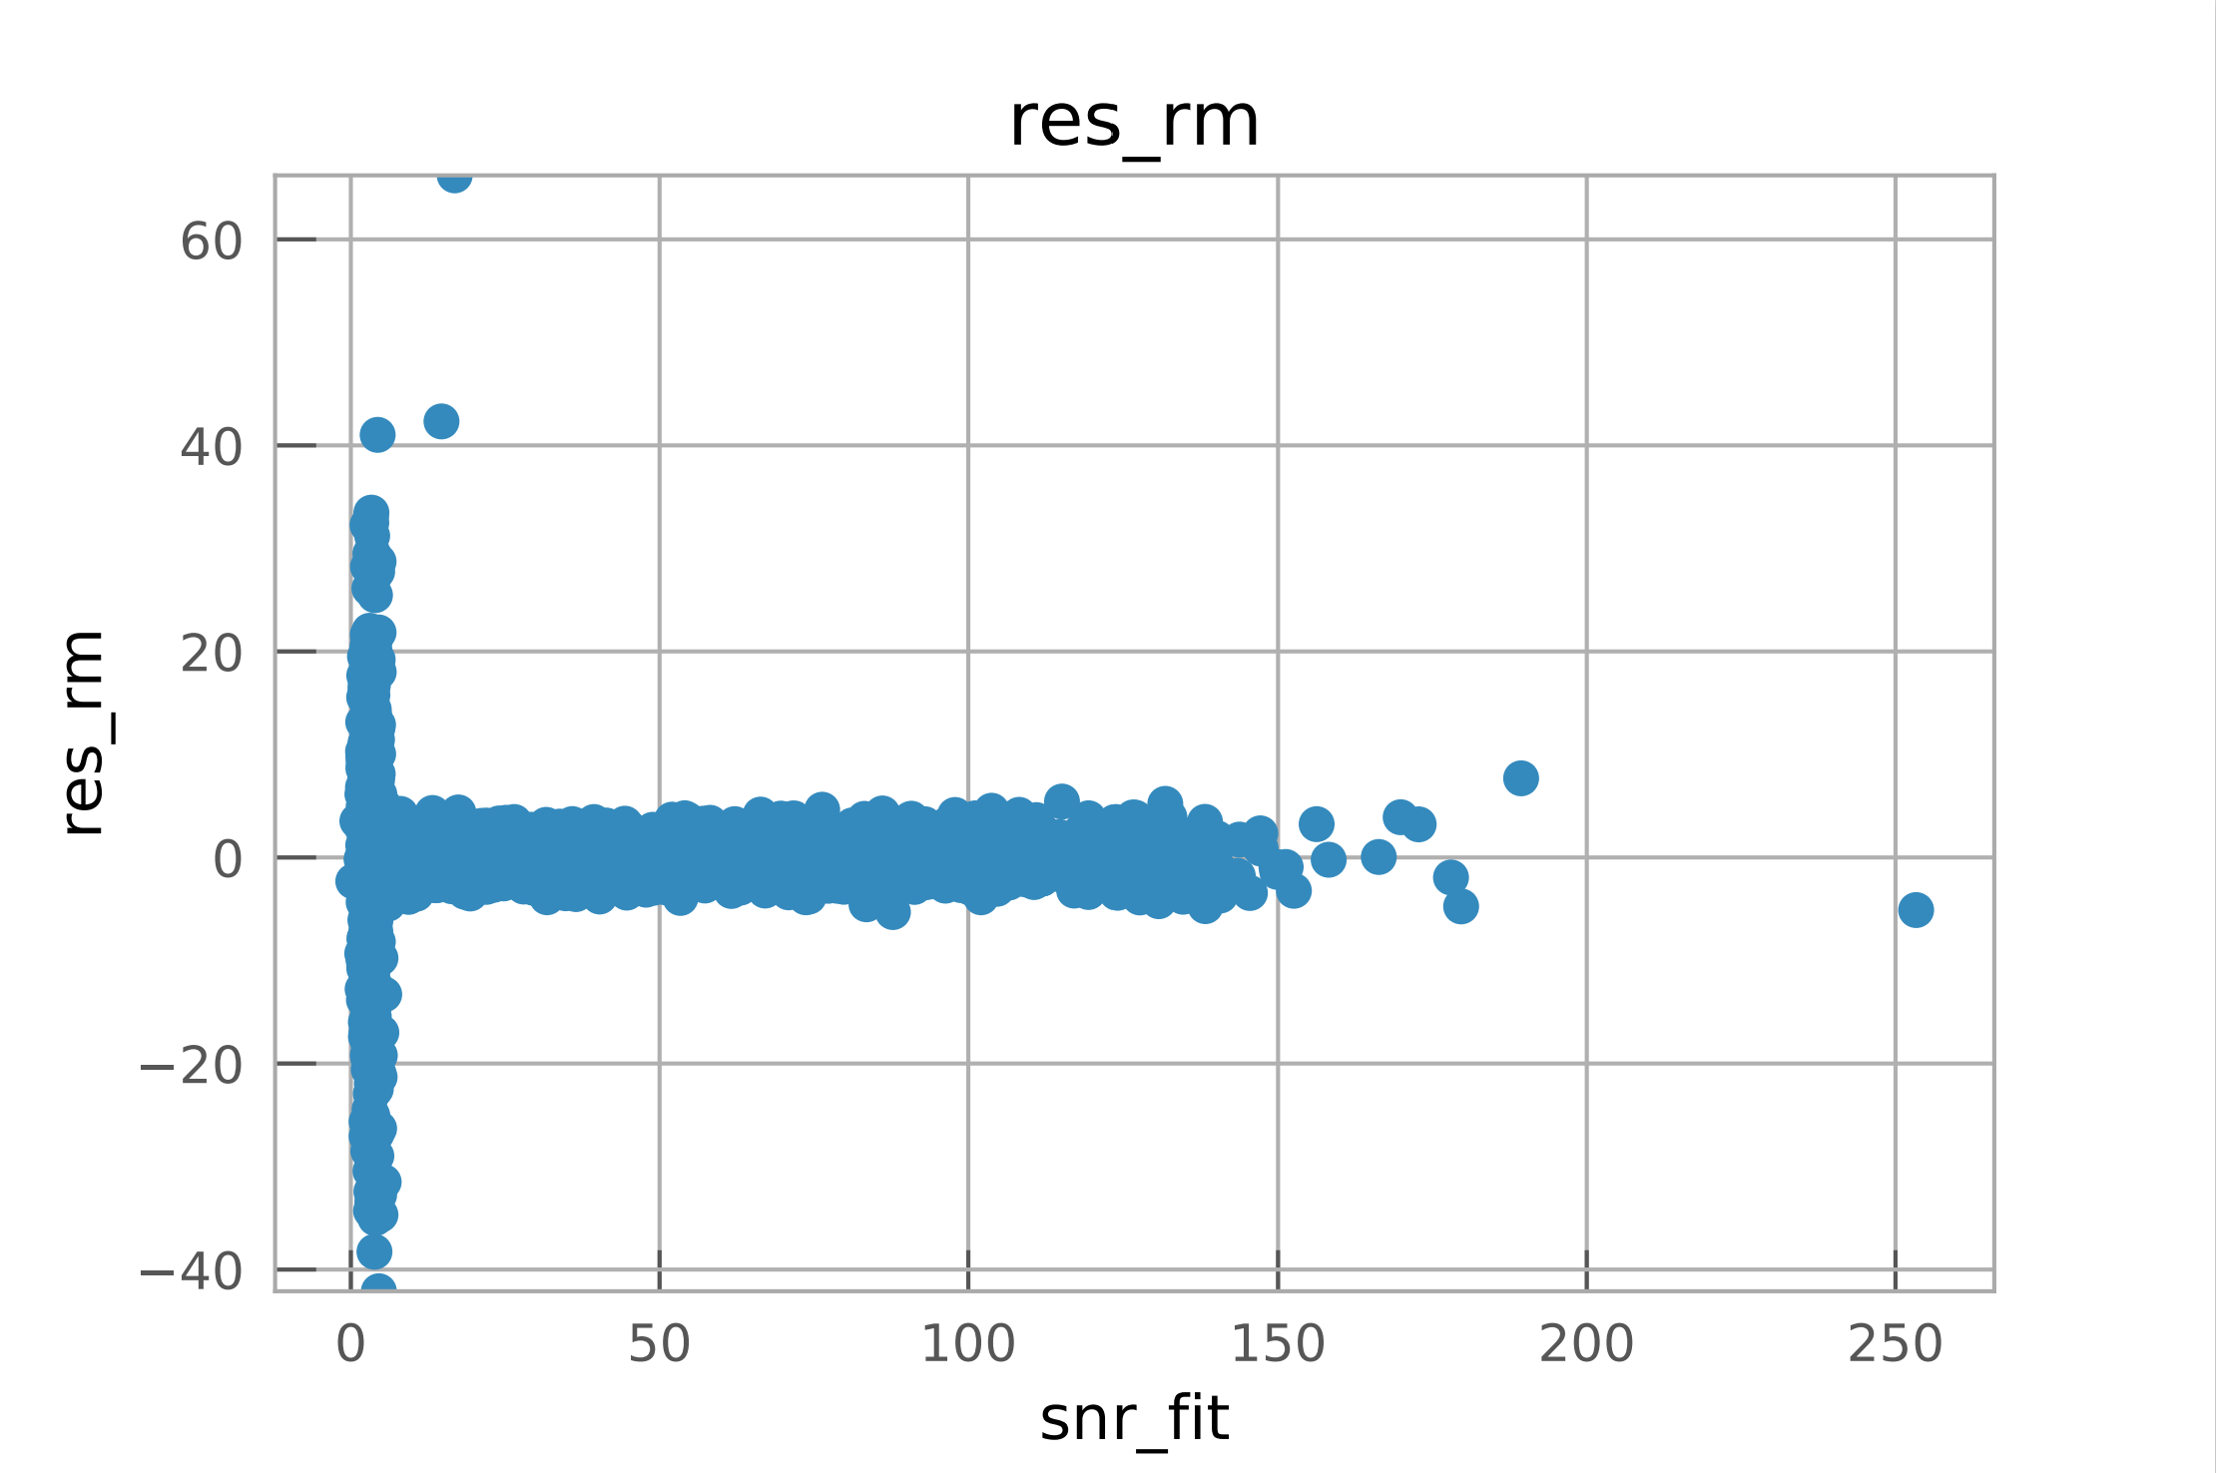
Raw RM Residual
Normalized RM Residual
Error ( rad/m²)
Error
Signal to Noise (SNR)
Signal to Noise (SNR)

Slide 11
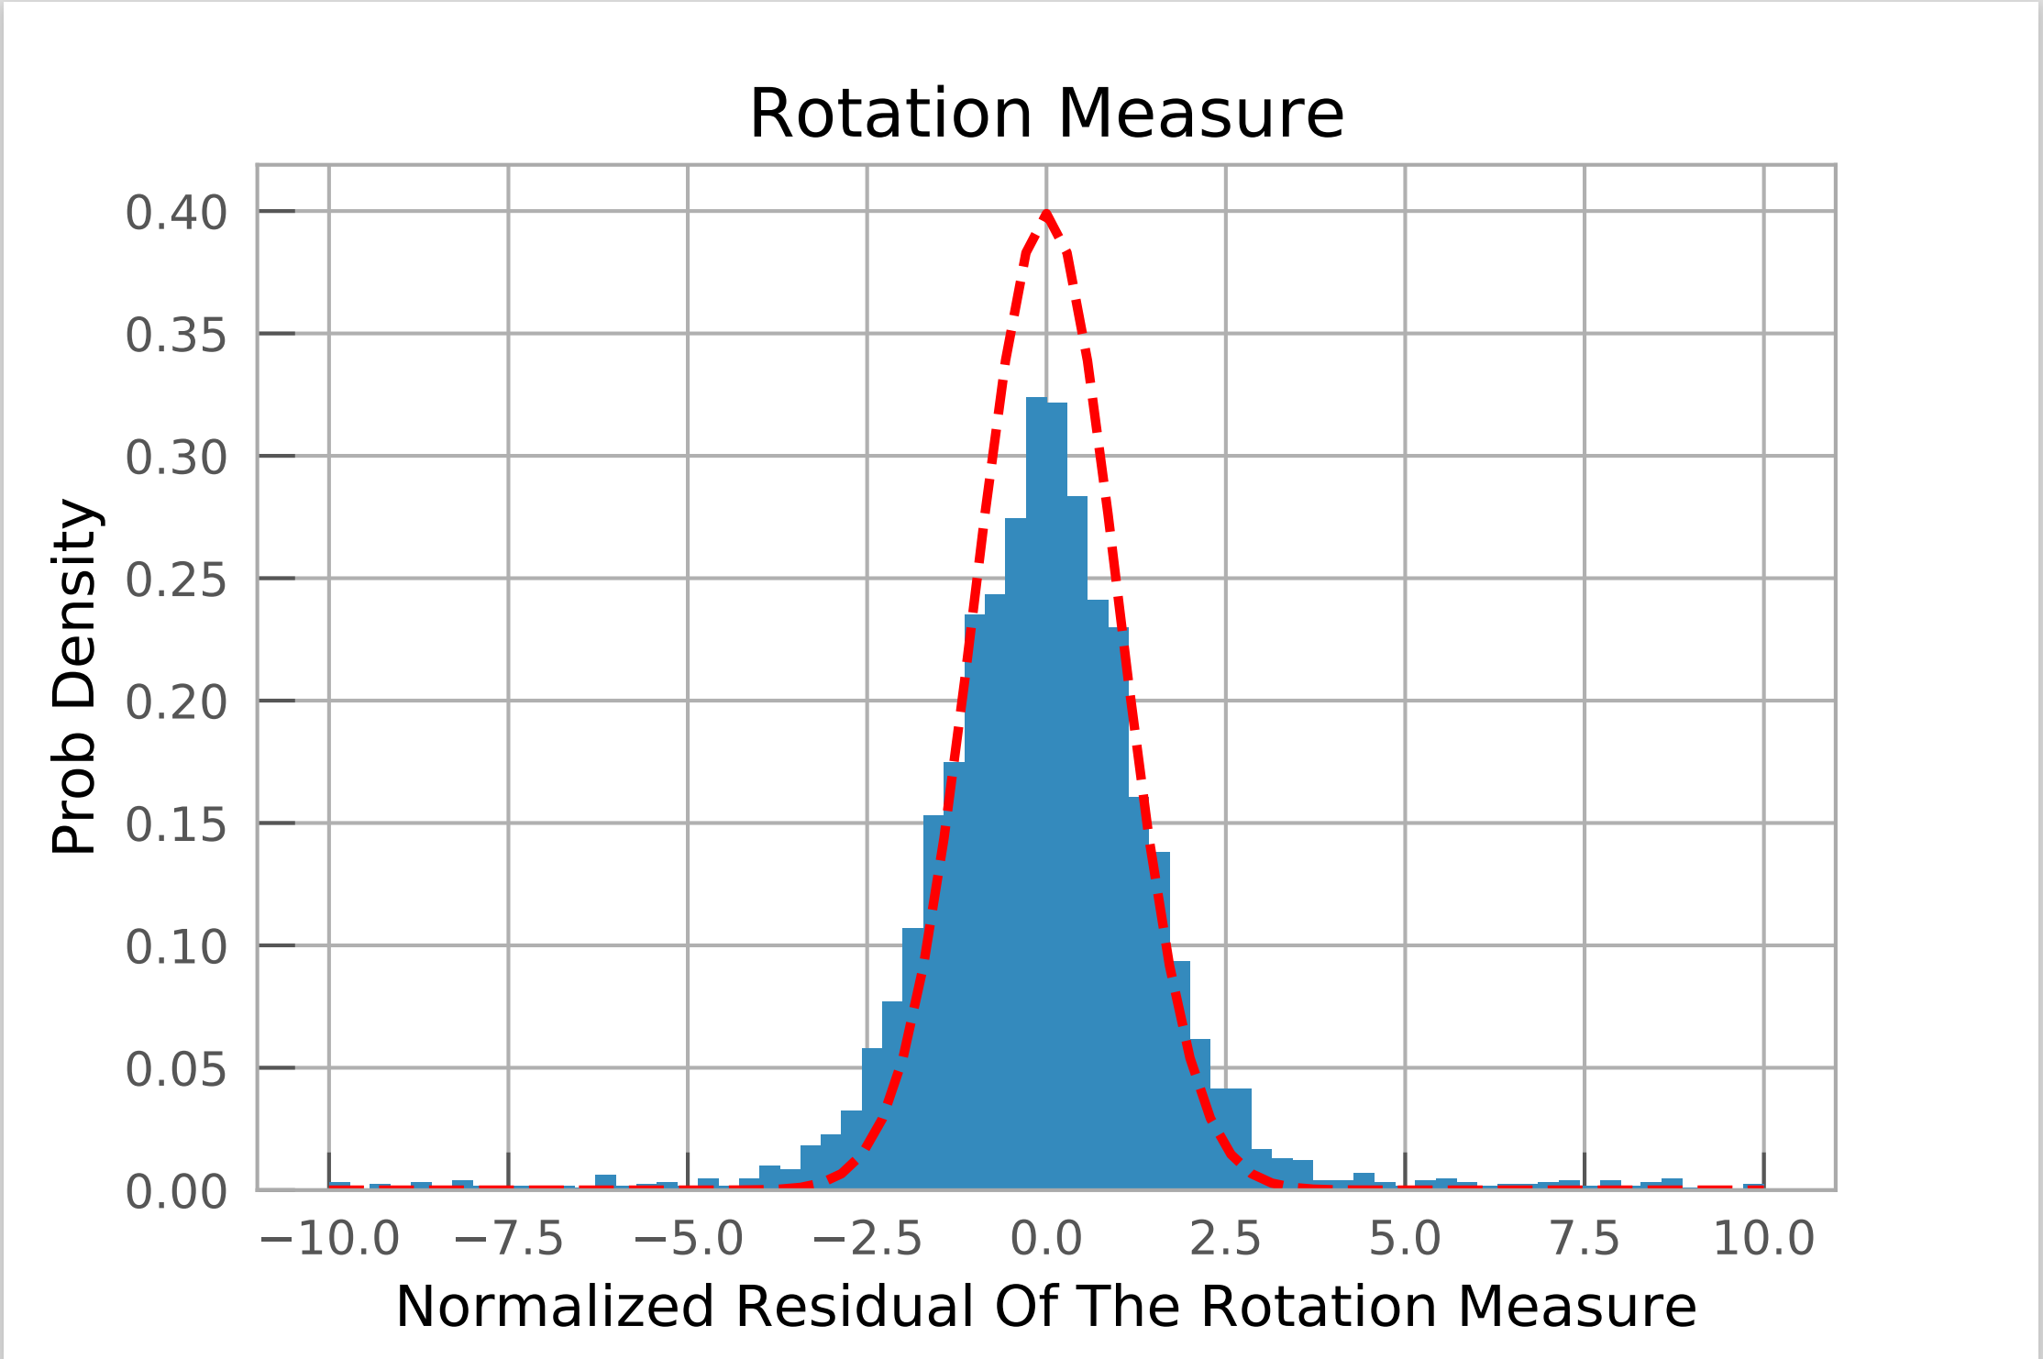
This is after filters were applied to remove:
Negative total flux sources
RM greater than was simulated
Less than 100 frequency channels
Non-Detections
Quantiles also analyzed:
Derotated angle
Fractional polarization
Polarized intensity
I₀

Slide 12
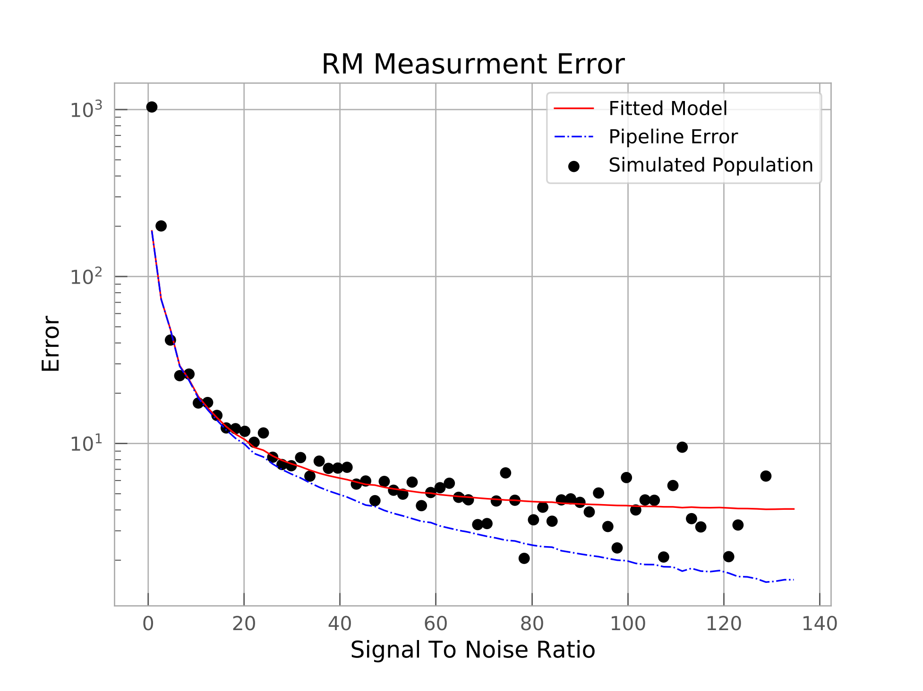

The pipeline error is FWHM/(2*SNR)
The model is adding a new unknown error in quadrature
Model = $\sqrt{{Pipeline Error}^{2}+a^{2}}$
a = 3.6139

